Slide 1
Peripheral Ports & Cables

Slide 2
Peripheral Ports & Cables
A port is a physical docking point using which an external device can be connected to the computer. It can also be programmatic docking point through which information flows from a program to the computer or over the Internet.
https://www.tutorialspoint.com/computer_fundamentals/computer_ports.htm

Slide 3
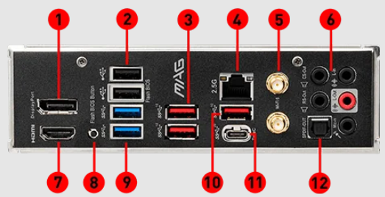
Peripheral ports

Slide 4
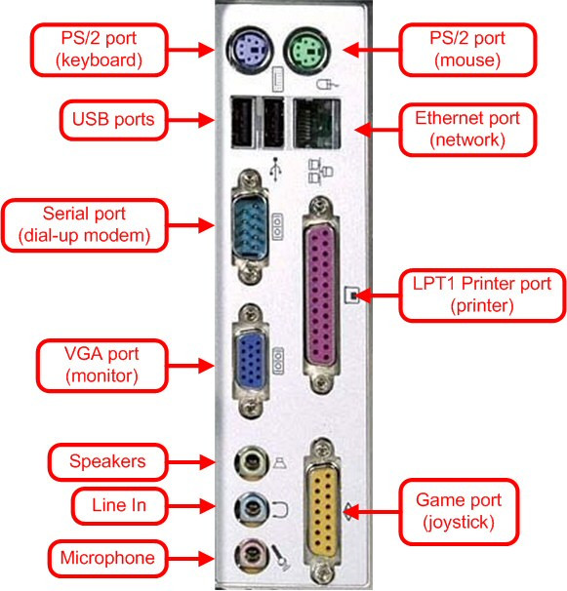
Peripheral Ports

Slide 5
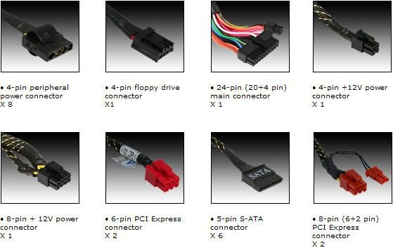
Associated cables

Slide 6
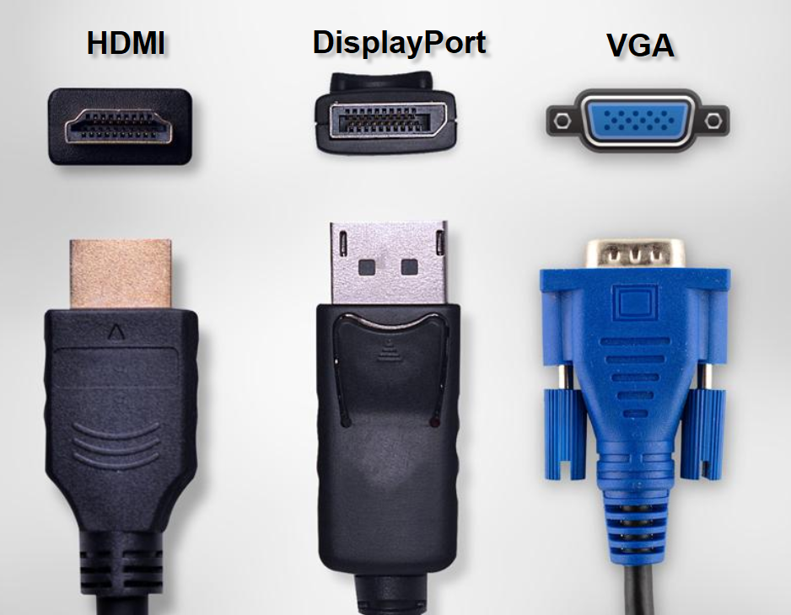
Associated cables

Slide 7
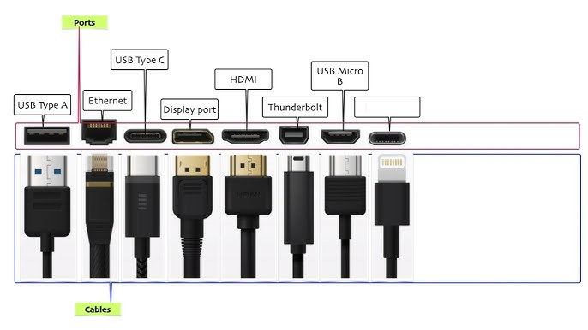
Associated cables

Slide 8
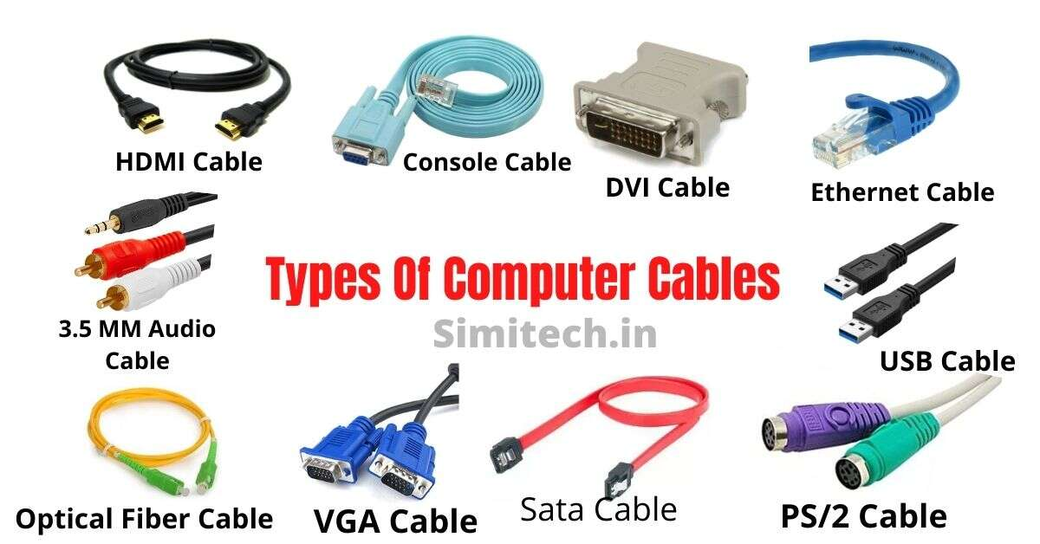
Associated cables

Slide 9
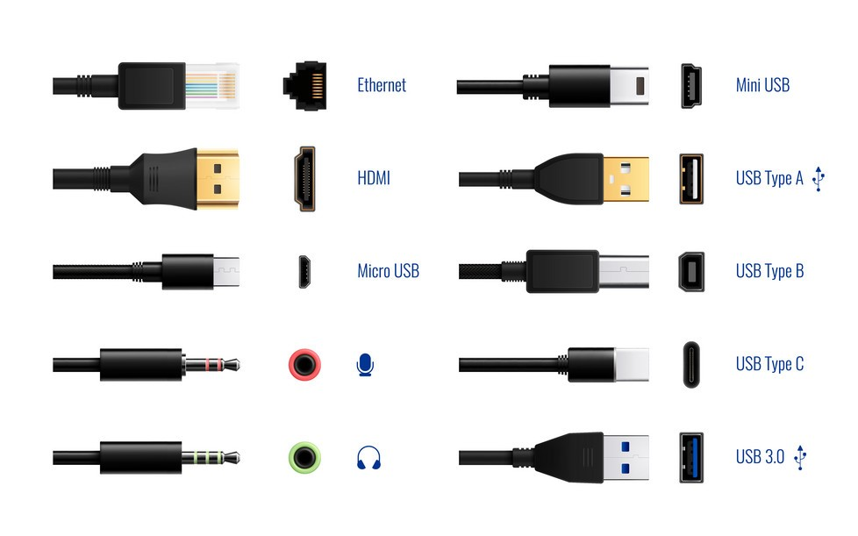
Associated cables

Slide 10
Thank You

